Slide 1

Efficient Cross Traffic Control System
By :- Ravindu Athukorala
Lochana Abhyawardana
Heansuh Lee
Kajeepan Umaibalan

Slide 2
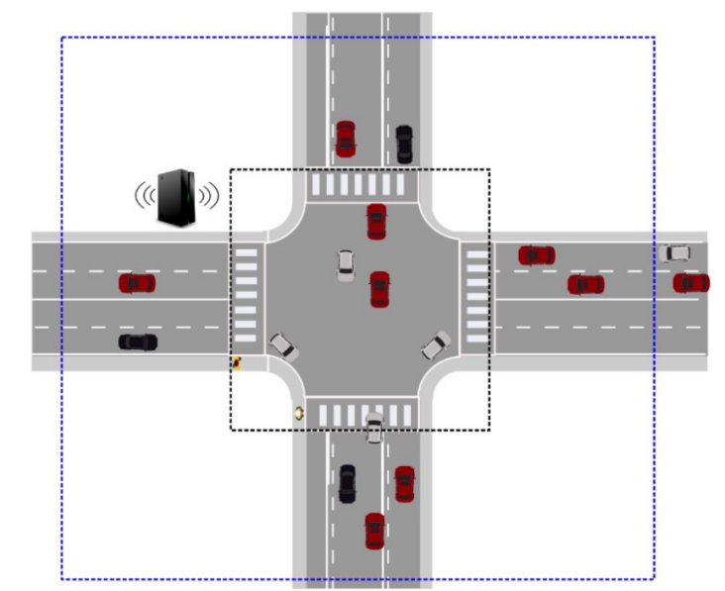

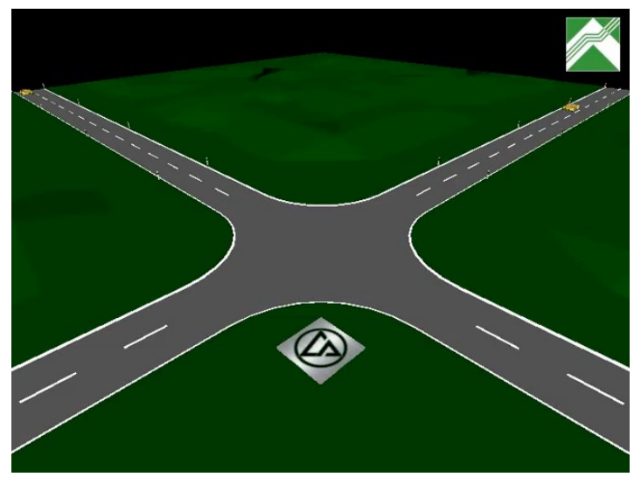
Motivation
10 units
Junction
2 units
Intersection
2x2 intersection matrix

Slide 3
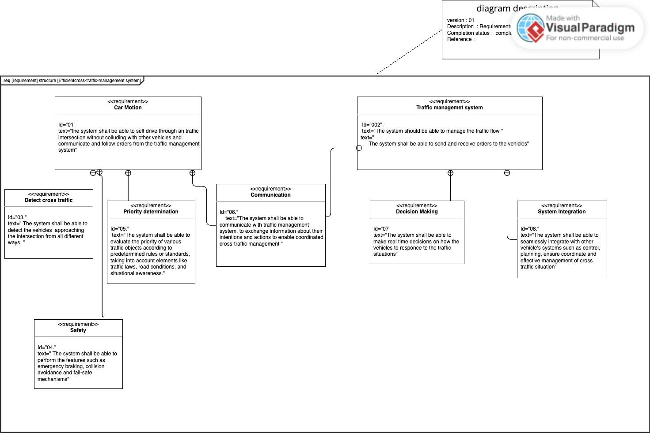
UML Requirement Diagram

Slide 4
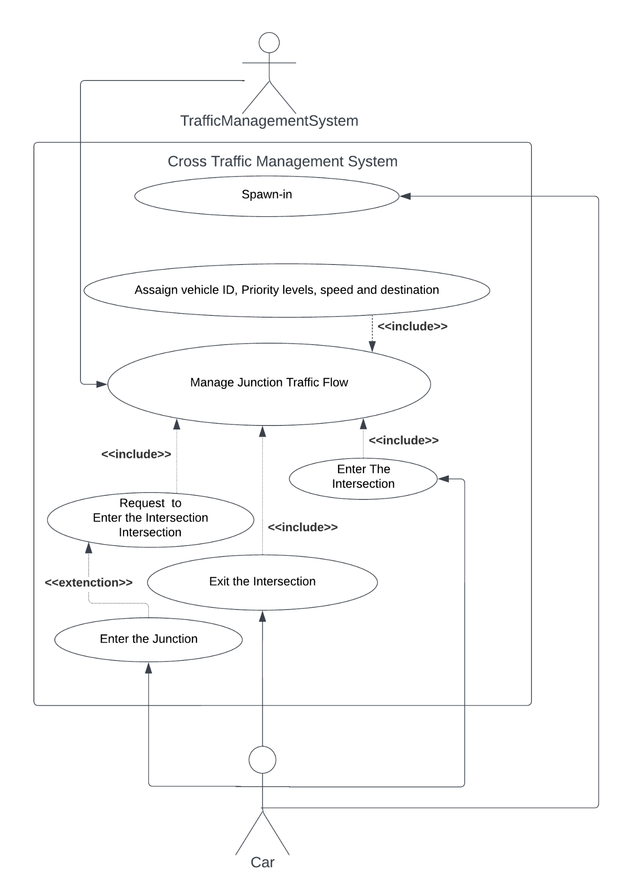
Use Case Diagram

Slide 5
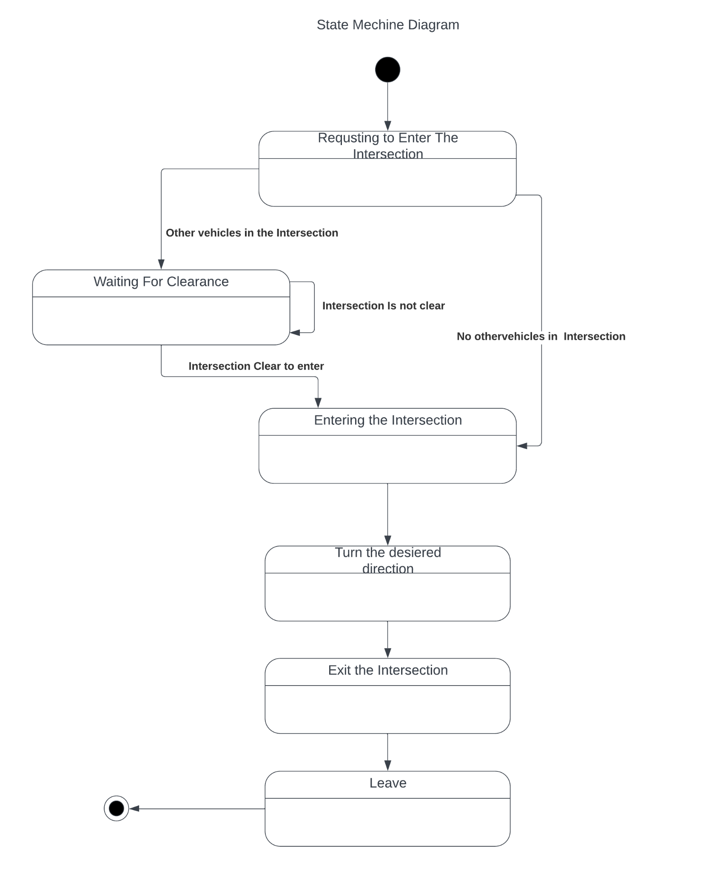
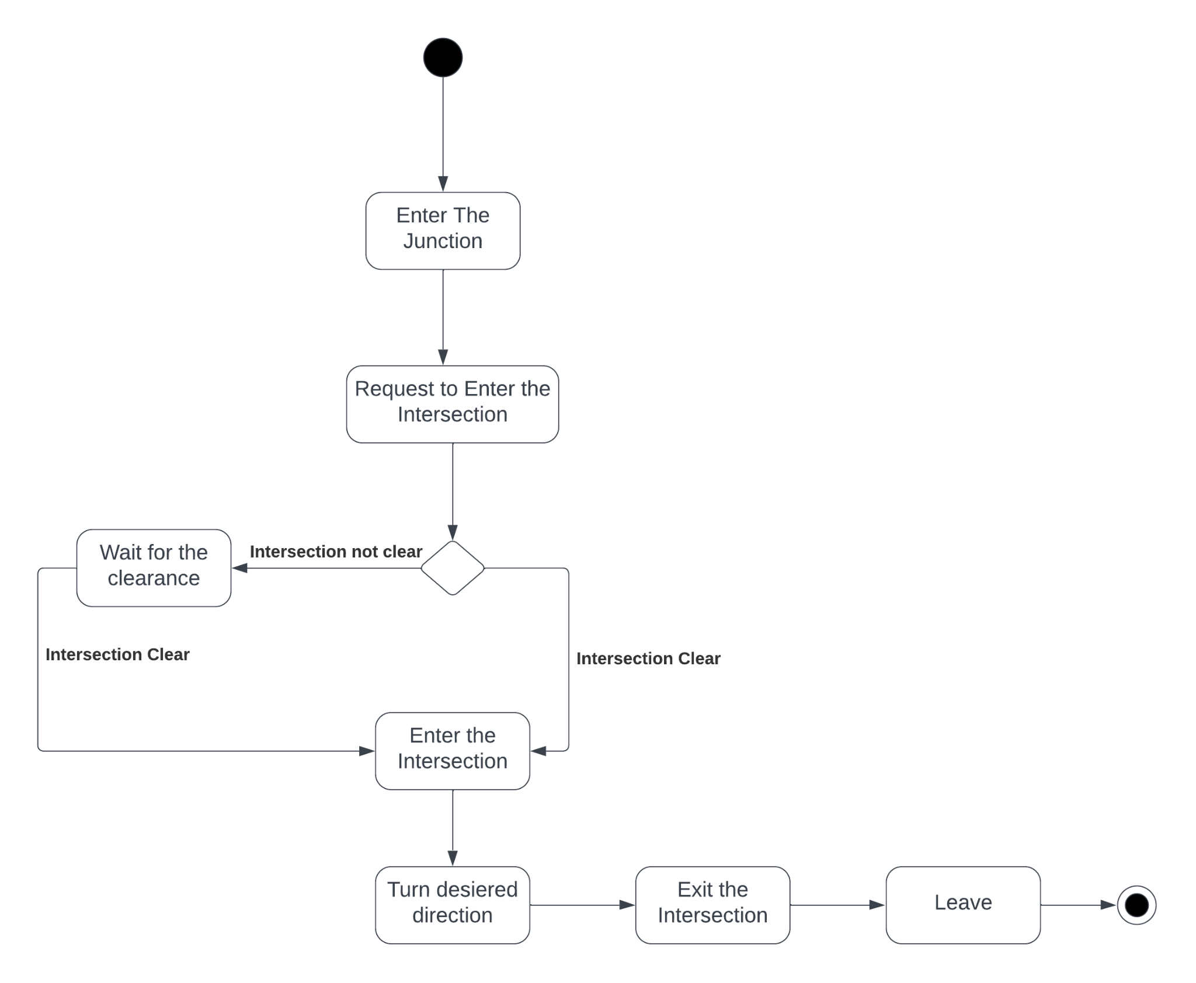
Activity Diagram

Slide 6
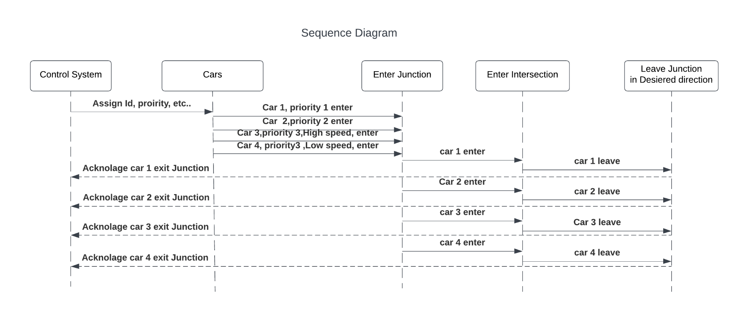
Sequence Diagram

Slide 7
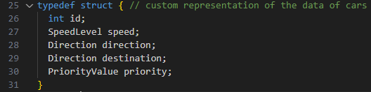
Implementation In C
Spawning Algorithm
Structs
Vehicle Spawn Function
Generating Randoms

Slide 8
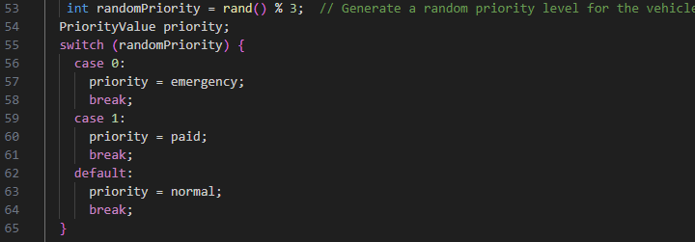
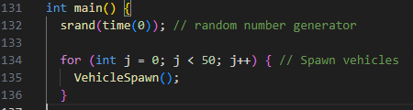
Switch case
Main function

Slide 9

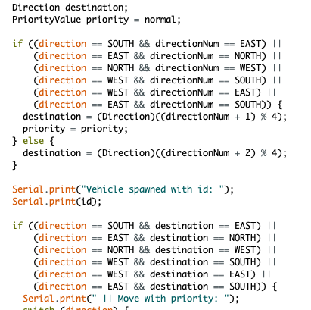
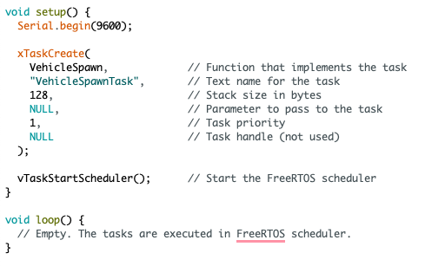
FreeRTOS Implementation

Slide 10
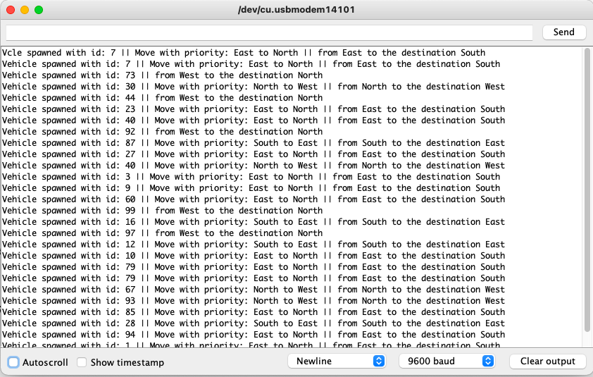

Slide 11
Scheduling Algorithm
Shortest Remaining Time First (SRTF)
Preemptive scheduling method
Derived from the Shortest Job First (SJF) scheduling algorithm
Difference: SRTF is preemptive, but SJF is non-preemptive [1]
2 essential elements, in the crossroad traffic control:
Speed of the vehicle (1-3 units/time unit) before entering junction
Intersection matrix units, based on destination lane selected (1-3 units)
Determined in the junction of the crossroad traffic control i.e. in our model, it is 1 unit before the intersection

Slide 12
Priority Allocation
Assumption: All the cars at the junction/intersection NEVER collide, due to their speed variations (i.e. speeds are similar, in junction/intersection)
Priority based on intersection units > priority based on speed before junction
Two cars are of same priority based on the intersection units, priority based on speed before junction takes over i.e. raising the priority of the car with a higher speed
Two cars are heading straight, there’s no collision, so both cars move together i.e. Priority 2: 2 units of intersection matrix units

Slide 13
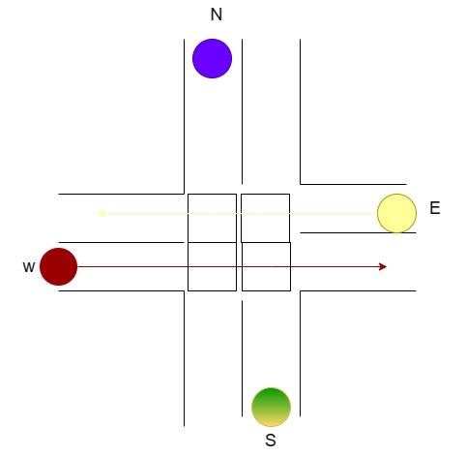

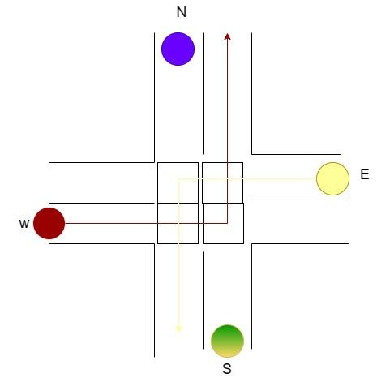
Visual Implementation
Of UPPAAL And VHDL Code
Main scenario
Car 1 - WN
Car 2 - NS
Car 3 - SN
Car 4 - ES
E
E
S
Priority 1
Priority 2
Priority 3

Slide 14
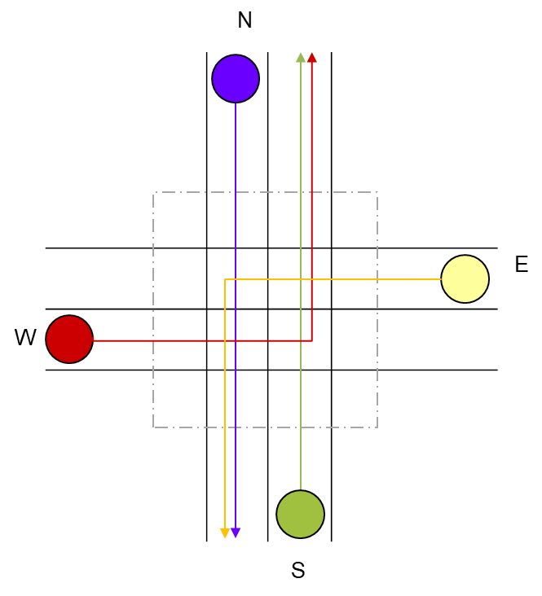
Visual Implementation
Of UPPAAL And VHDL Code
Main scenario
Car 1 - WN
Car 2 - NS
Car 3 - SN
Car 4 - ES

Slide 15
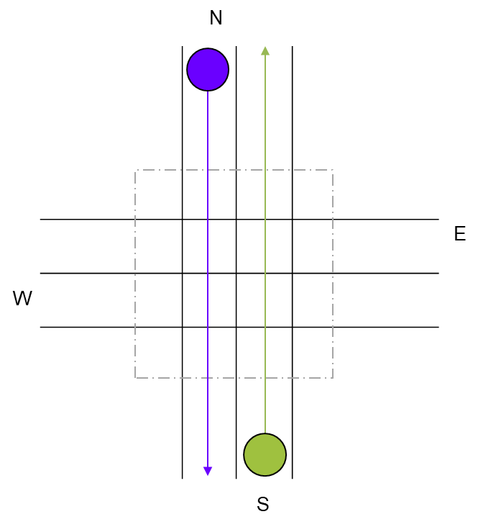
Visual Implementation
Of UPPAAL And VHDL Code
Main scenario
Car 1 - WN
Car 2 - NS
Car 3 - SN
Car 4 - ES

Slide 16
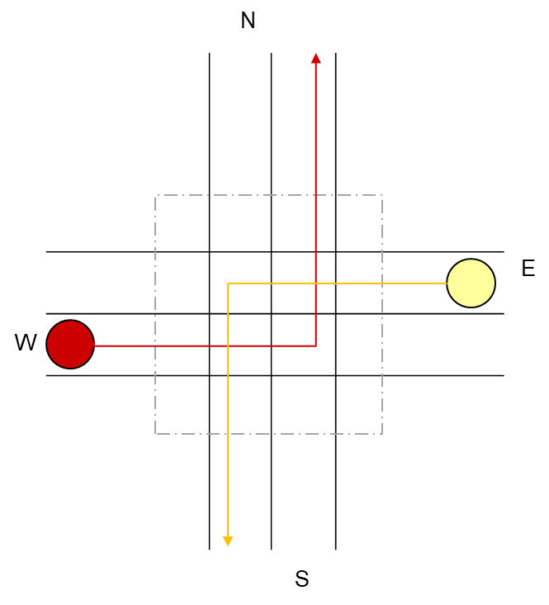
Visual Implementation
Of UPPAAL And VHDL Code
Main scenario
Car 1 - WN
Car 2 - NS
Car 3 - SN
Car 4 - ES

Slide 17

UPPAAL Implementation

Slide 18
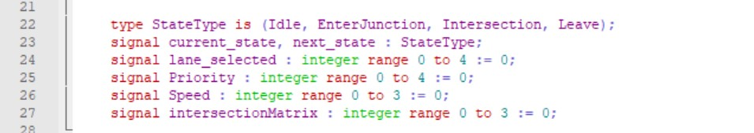
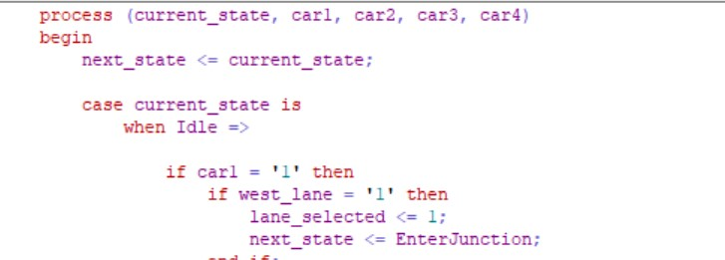
Hardware Codesign with implementation in Modelsim
Implementation for the scheduling code is done by states and assigning signal values

Slide 19
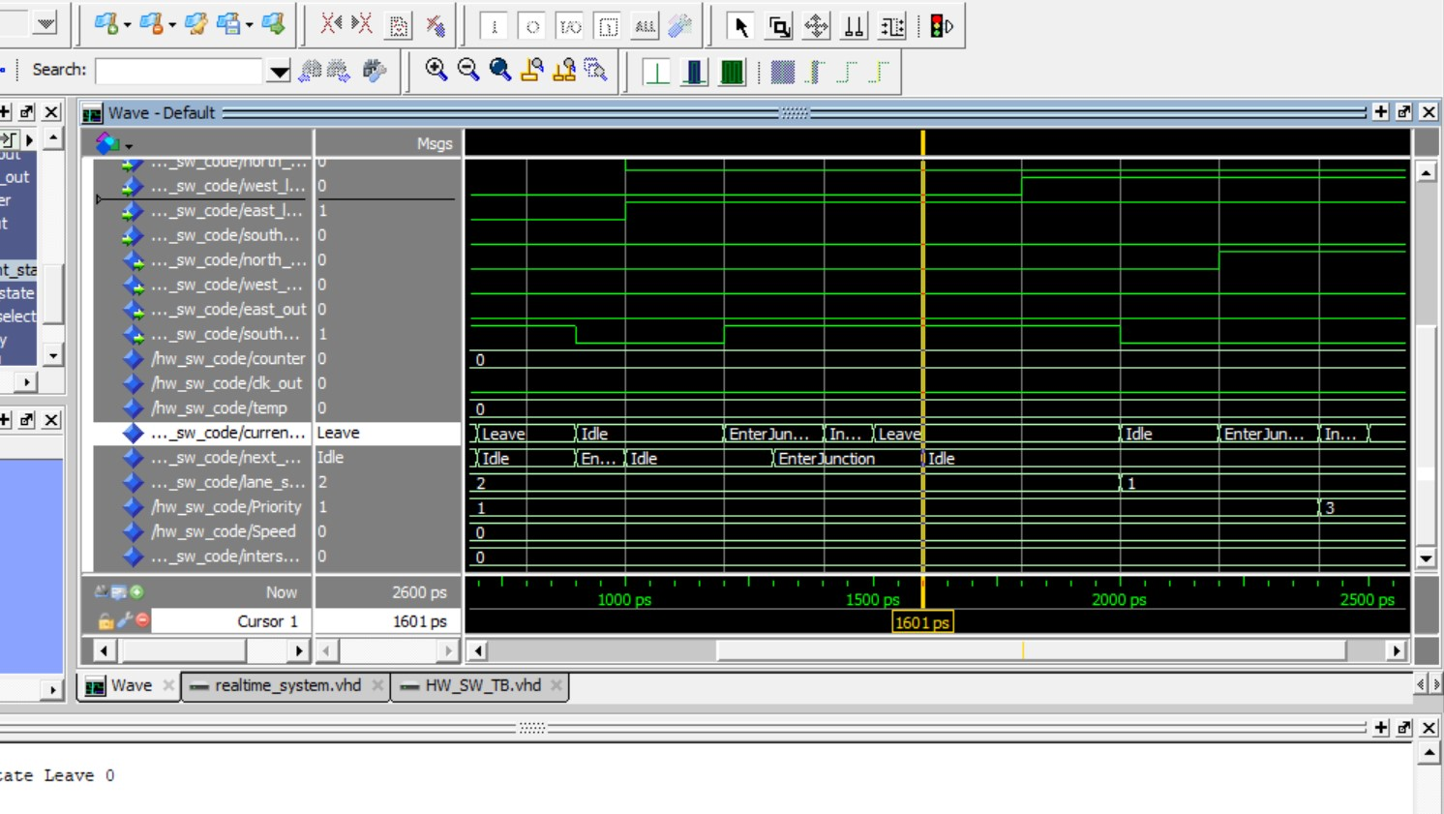
Simulation Model in Modelsim

Slide 20
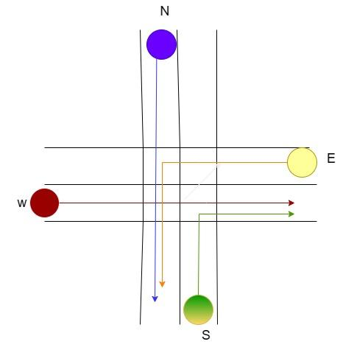
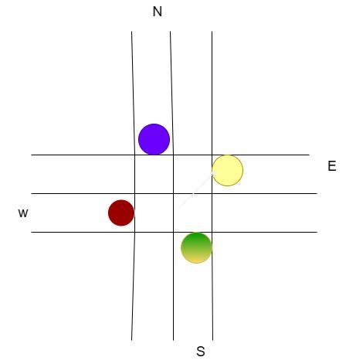
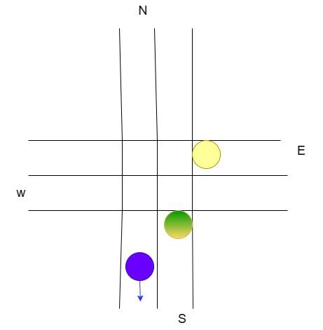
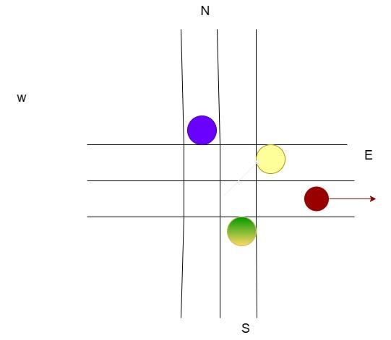
Scenario 2
Car 1: priority 1
Car 2: priority 2
Car 3: priority 3(High Speed)
Car 4: priority 3(LOW Speed)

Slide 21
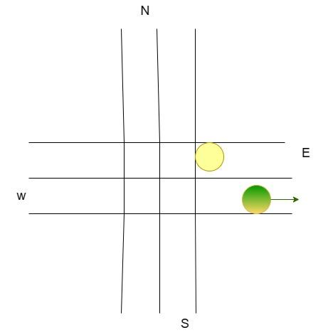
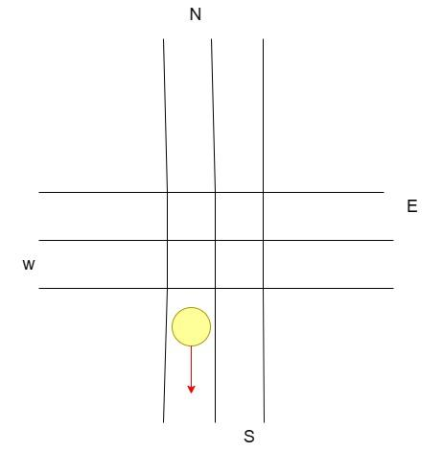

Slide 22
Summary
This project presents an efficient cross-traffic management control system for autonomous cars. The system utilizes the Short Remaining Time First (SRTF) algorithm to prioritize cars at intersections. It incorporates FreeRTOS C code for task management, VHDL code for system implementation, and UPPAAL modeling for verification. By assigning priority based on predefined rules, the system optimizes traffic flow, ensuring smoother and safer interactions between autonomous vehicles. The project demonstrates improved efficiency and performance, offering potential for future enhancements and advancements in traffic management for autonomous cars.

Slide 23
References
[1] Modern Operating Systems. Andrew S. Tanenbaum, Herbert Bos. Pearson Education, 2015. p.158.

